Slide 1

IBM Advanced Data Science Capstone
By Alex Counihan

Slide 2
Objectives
Use Case
Data Set
Data Quality Assessment
Data Exploration
Data Visualization
Feature Engineering
Model Performance Indicator
Model Select
Model Performance
Final Pipeline

Slide 3
Use Case
Under the Civil Aviation Authority masses of documentation are required for all aircraft maintenance
Most of this documentation is paper based
Archive rooms are wall to wall with documentation
Will be automating the storage process by automatically scanning, cleaning and archiving documents based of their details
Notes:
In the digital age of aviation we still have a mountain of paperwork associated with any work we do.
This paperwork is manually placed into numerical order by aircraft and then archived. This takes a lot of time and it extremely tedious. If a maintainer wants to refer to an archived document then they have to search for it through tens of thousands of physical documents.
To that end the use case I have selected is to automatically digitise scanned documents, then extract details from the sheets in order to archive with a name based on aircraft number and sheet number so that they can be found easily.

Slide 4

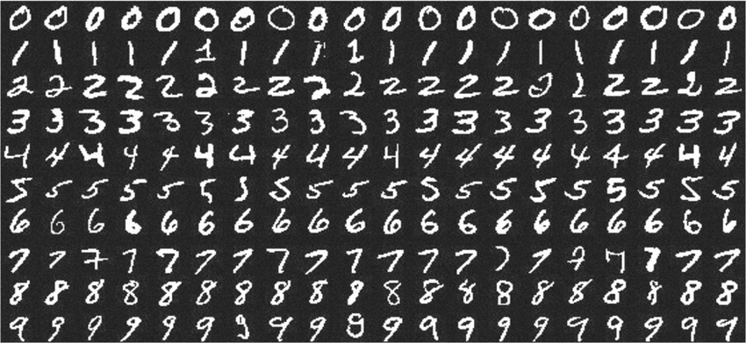
Data Set
MNIST Dataset
Kaggle’s A-Z Dataset

Slide 5
Data Quality Assessment and Visualisation
Confirmation of image sizes
Samples extracted for manual identification, “Dip testing”
Reading of associated documentation for peer evaluations of datasets

Slide 6
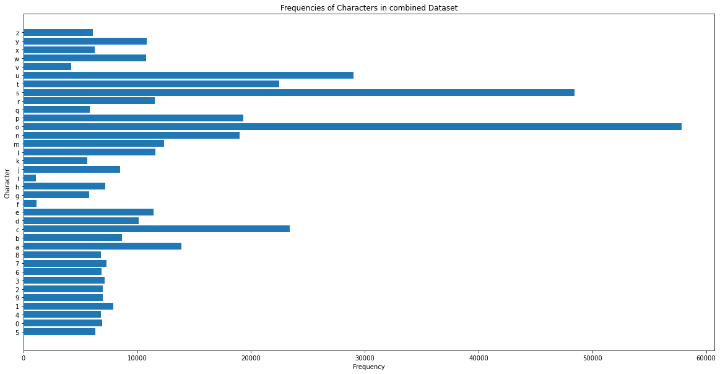
Data Exploration

Slide 7
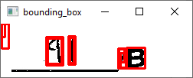
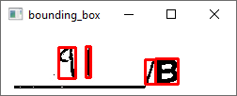
Feature Engineering
SCIPY’s Signal Median 2d Filter
Load image
Convert to grayscale
Normalise array to 0-1
Extract the background
Mask the original image with the background
Reduces erroneous contours

Slide 8
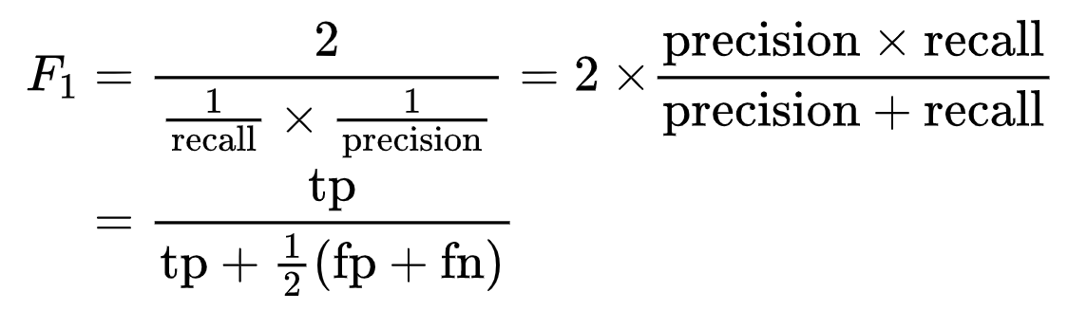
Model Performance Indicator
F1 Score
Calculated for all Classes
Weighted Average Taken

Slide 9
Model Selection
Metric | KNN Classifier | ResNet50 Classifier
Training Time | 1088.7 Seconds | 184.2 Seconds
Prediction Time (All Validation Data) | 7267 Seconds | 41.9 Seconds
Prediction Time (Single Image) | 0.07 Seconds | 0.0003 Seconds
Weighted Average F1 Score | 0.91 | 0.95

Slide 10
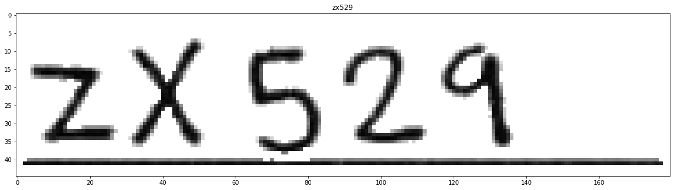
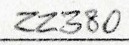
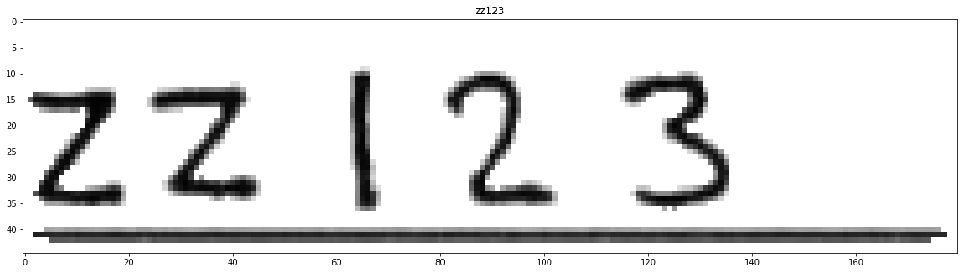
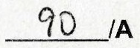
Performances by Changes
ZX529
22B80
ZZ123
F1901A

Slide 11
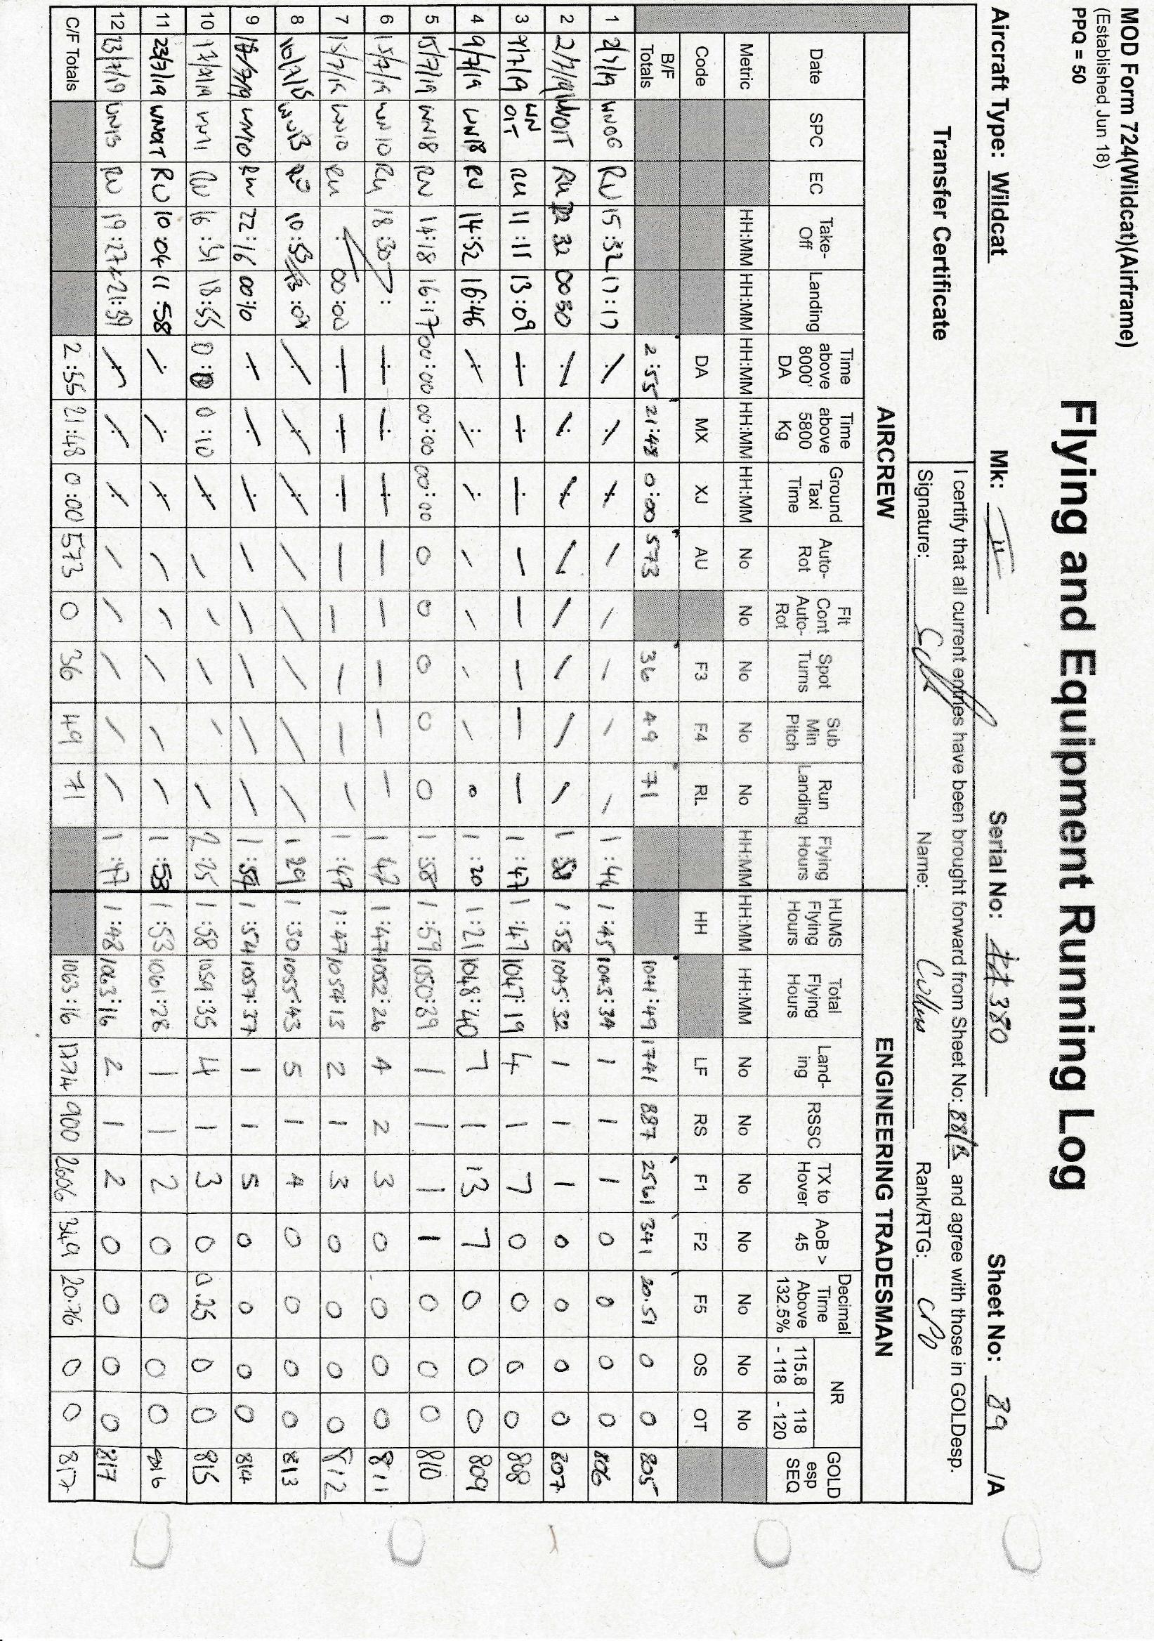
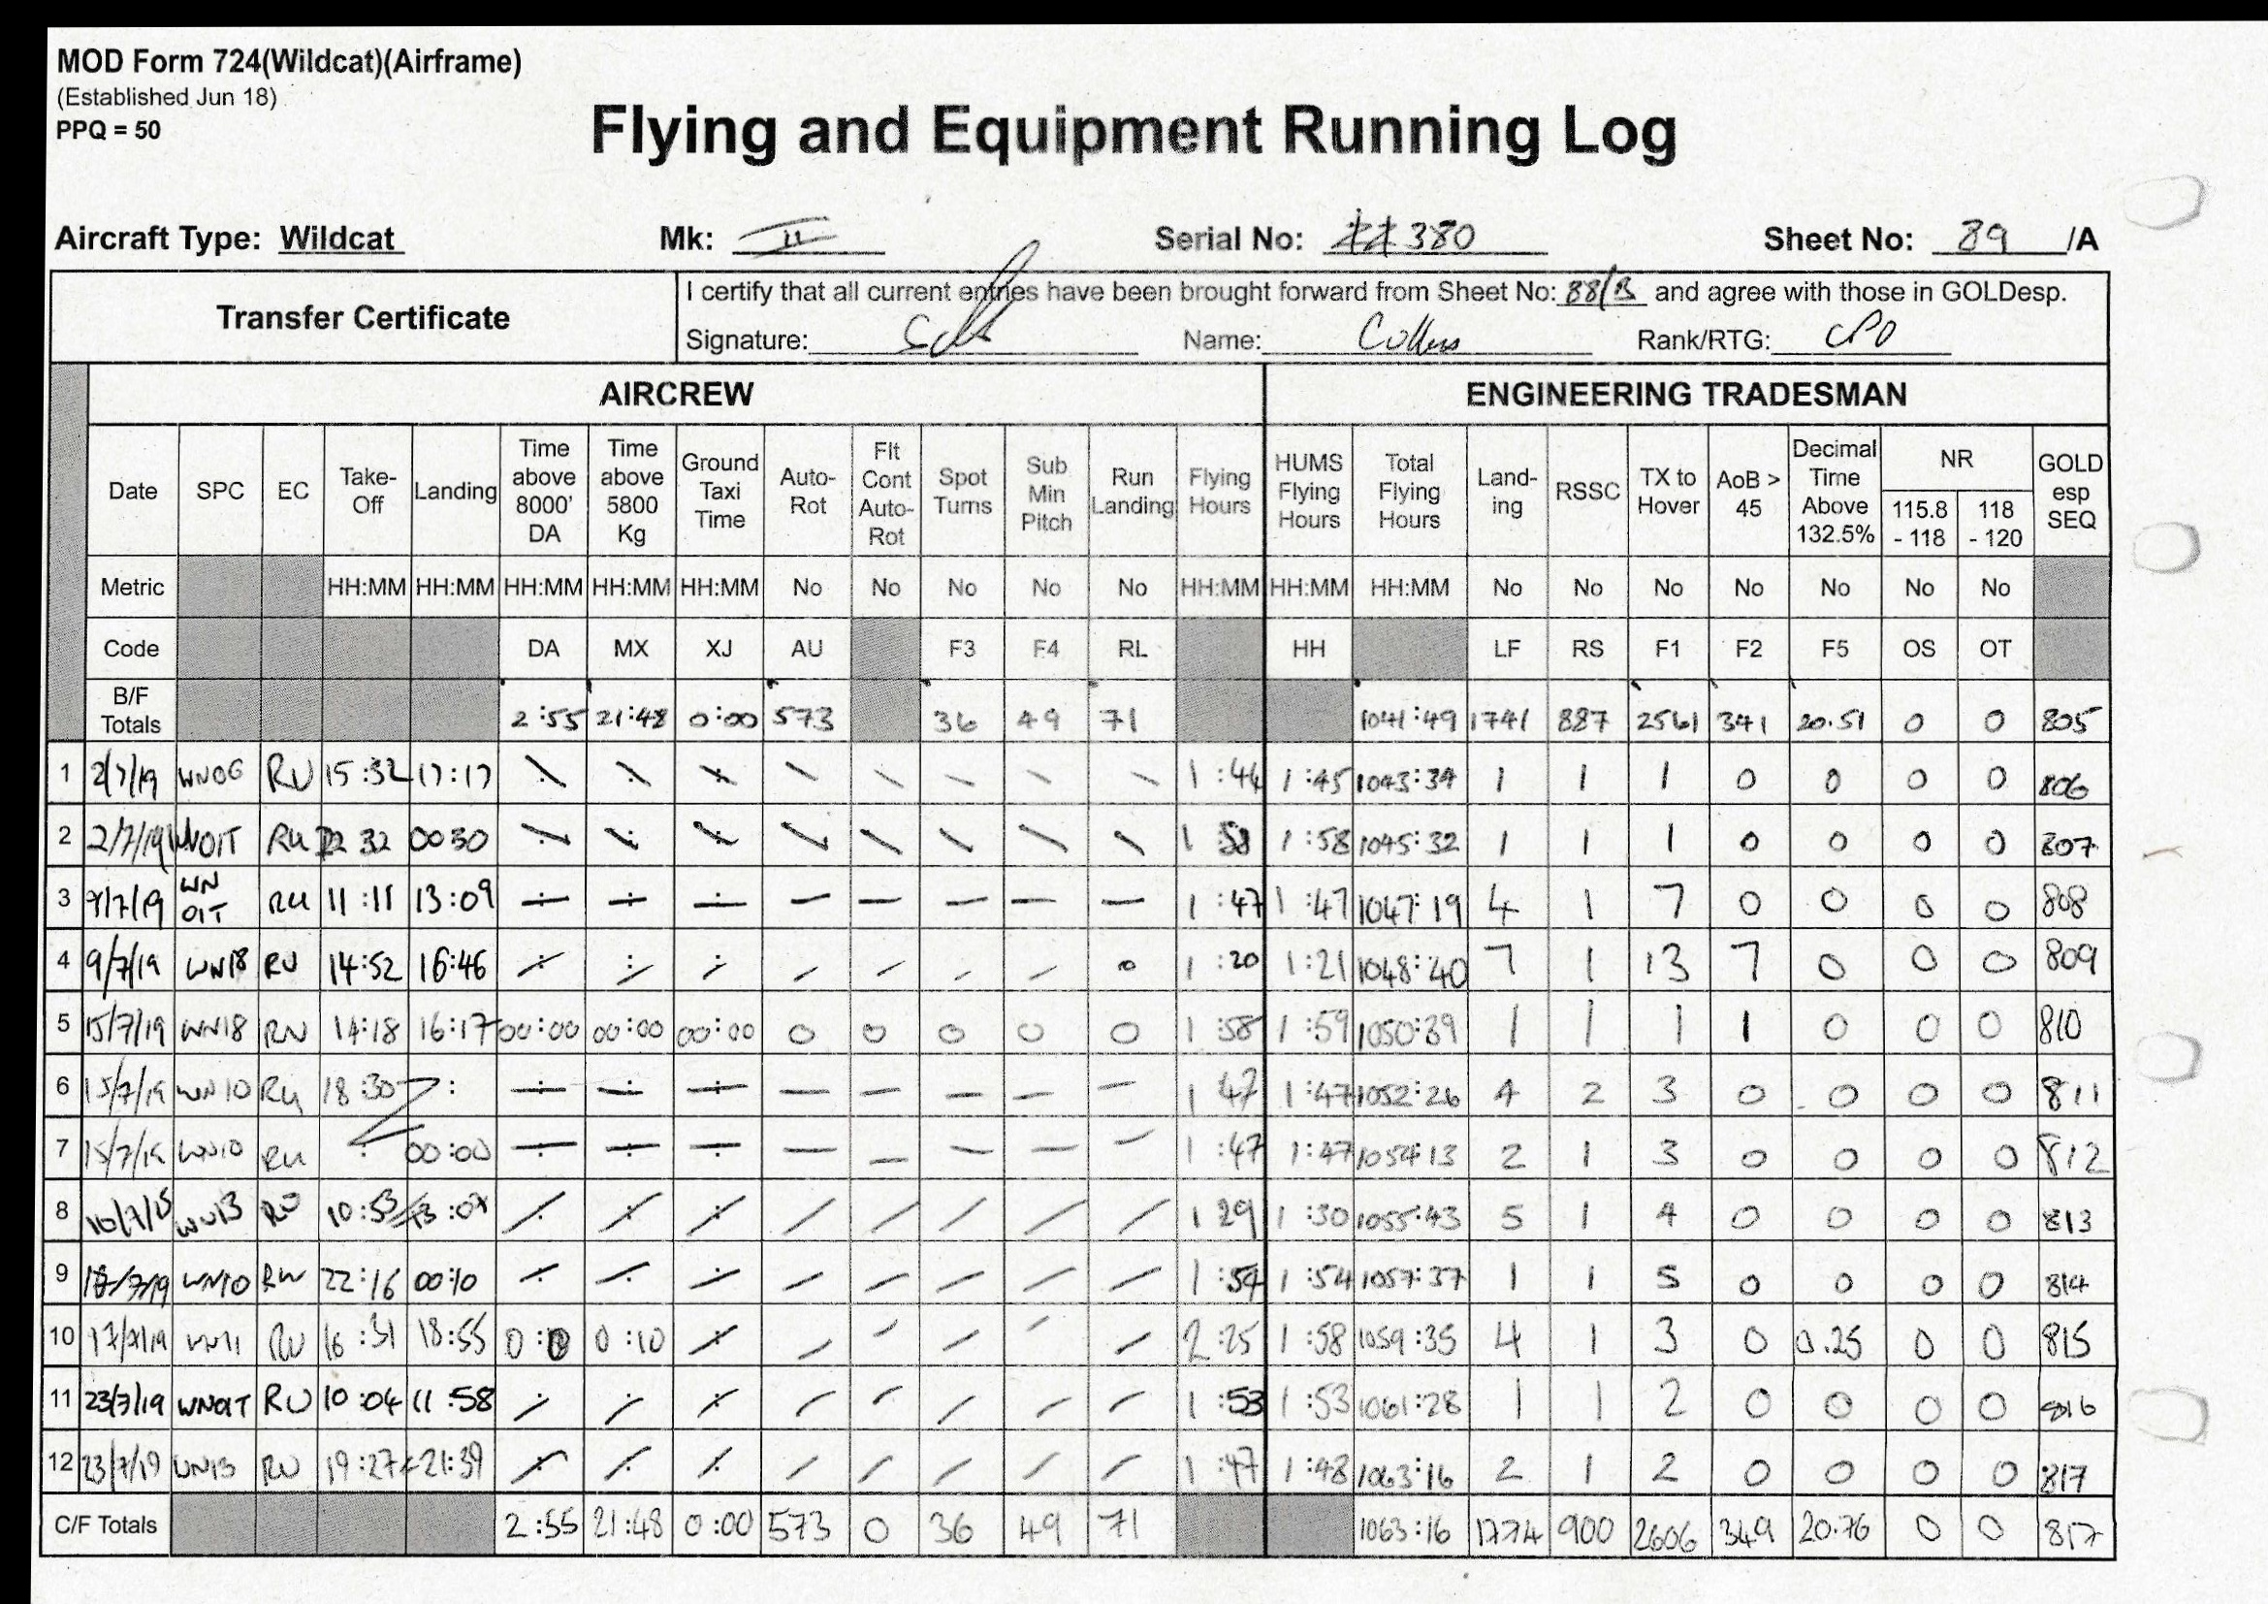
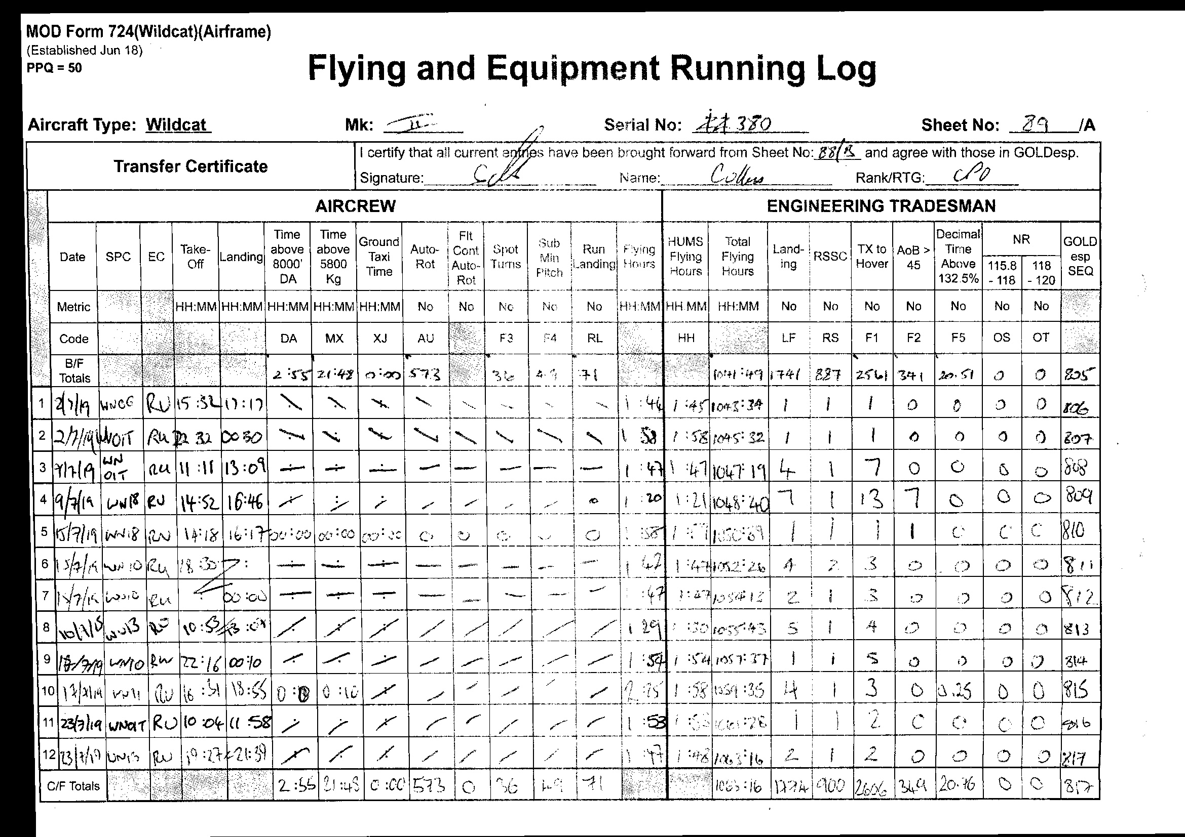

Final Pipeline
Aircraft Serial Number Extracted and OCR’d
Sheet Number Extracted and OCR’d
Raw Documents Scanned
Images extracted from .pdf files, oriented with Homography
Images de-noised using median filtering
Clean Document Named with OCR’d details
Users able to access all data electronically
Document Uploaded to Enterprise Data Warehouse

